Slide 1


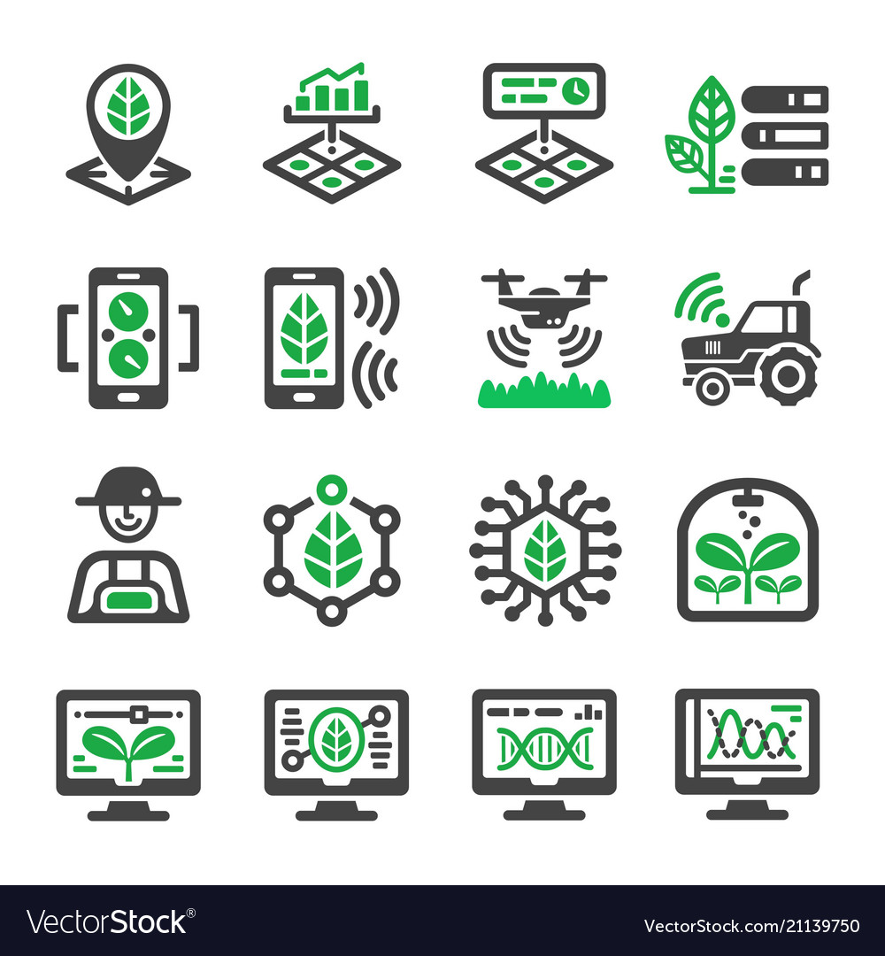
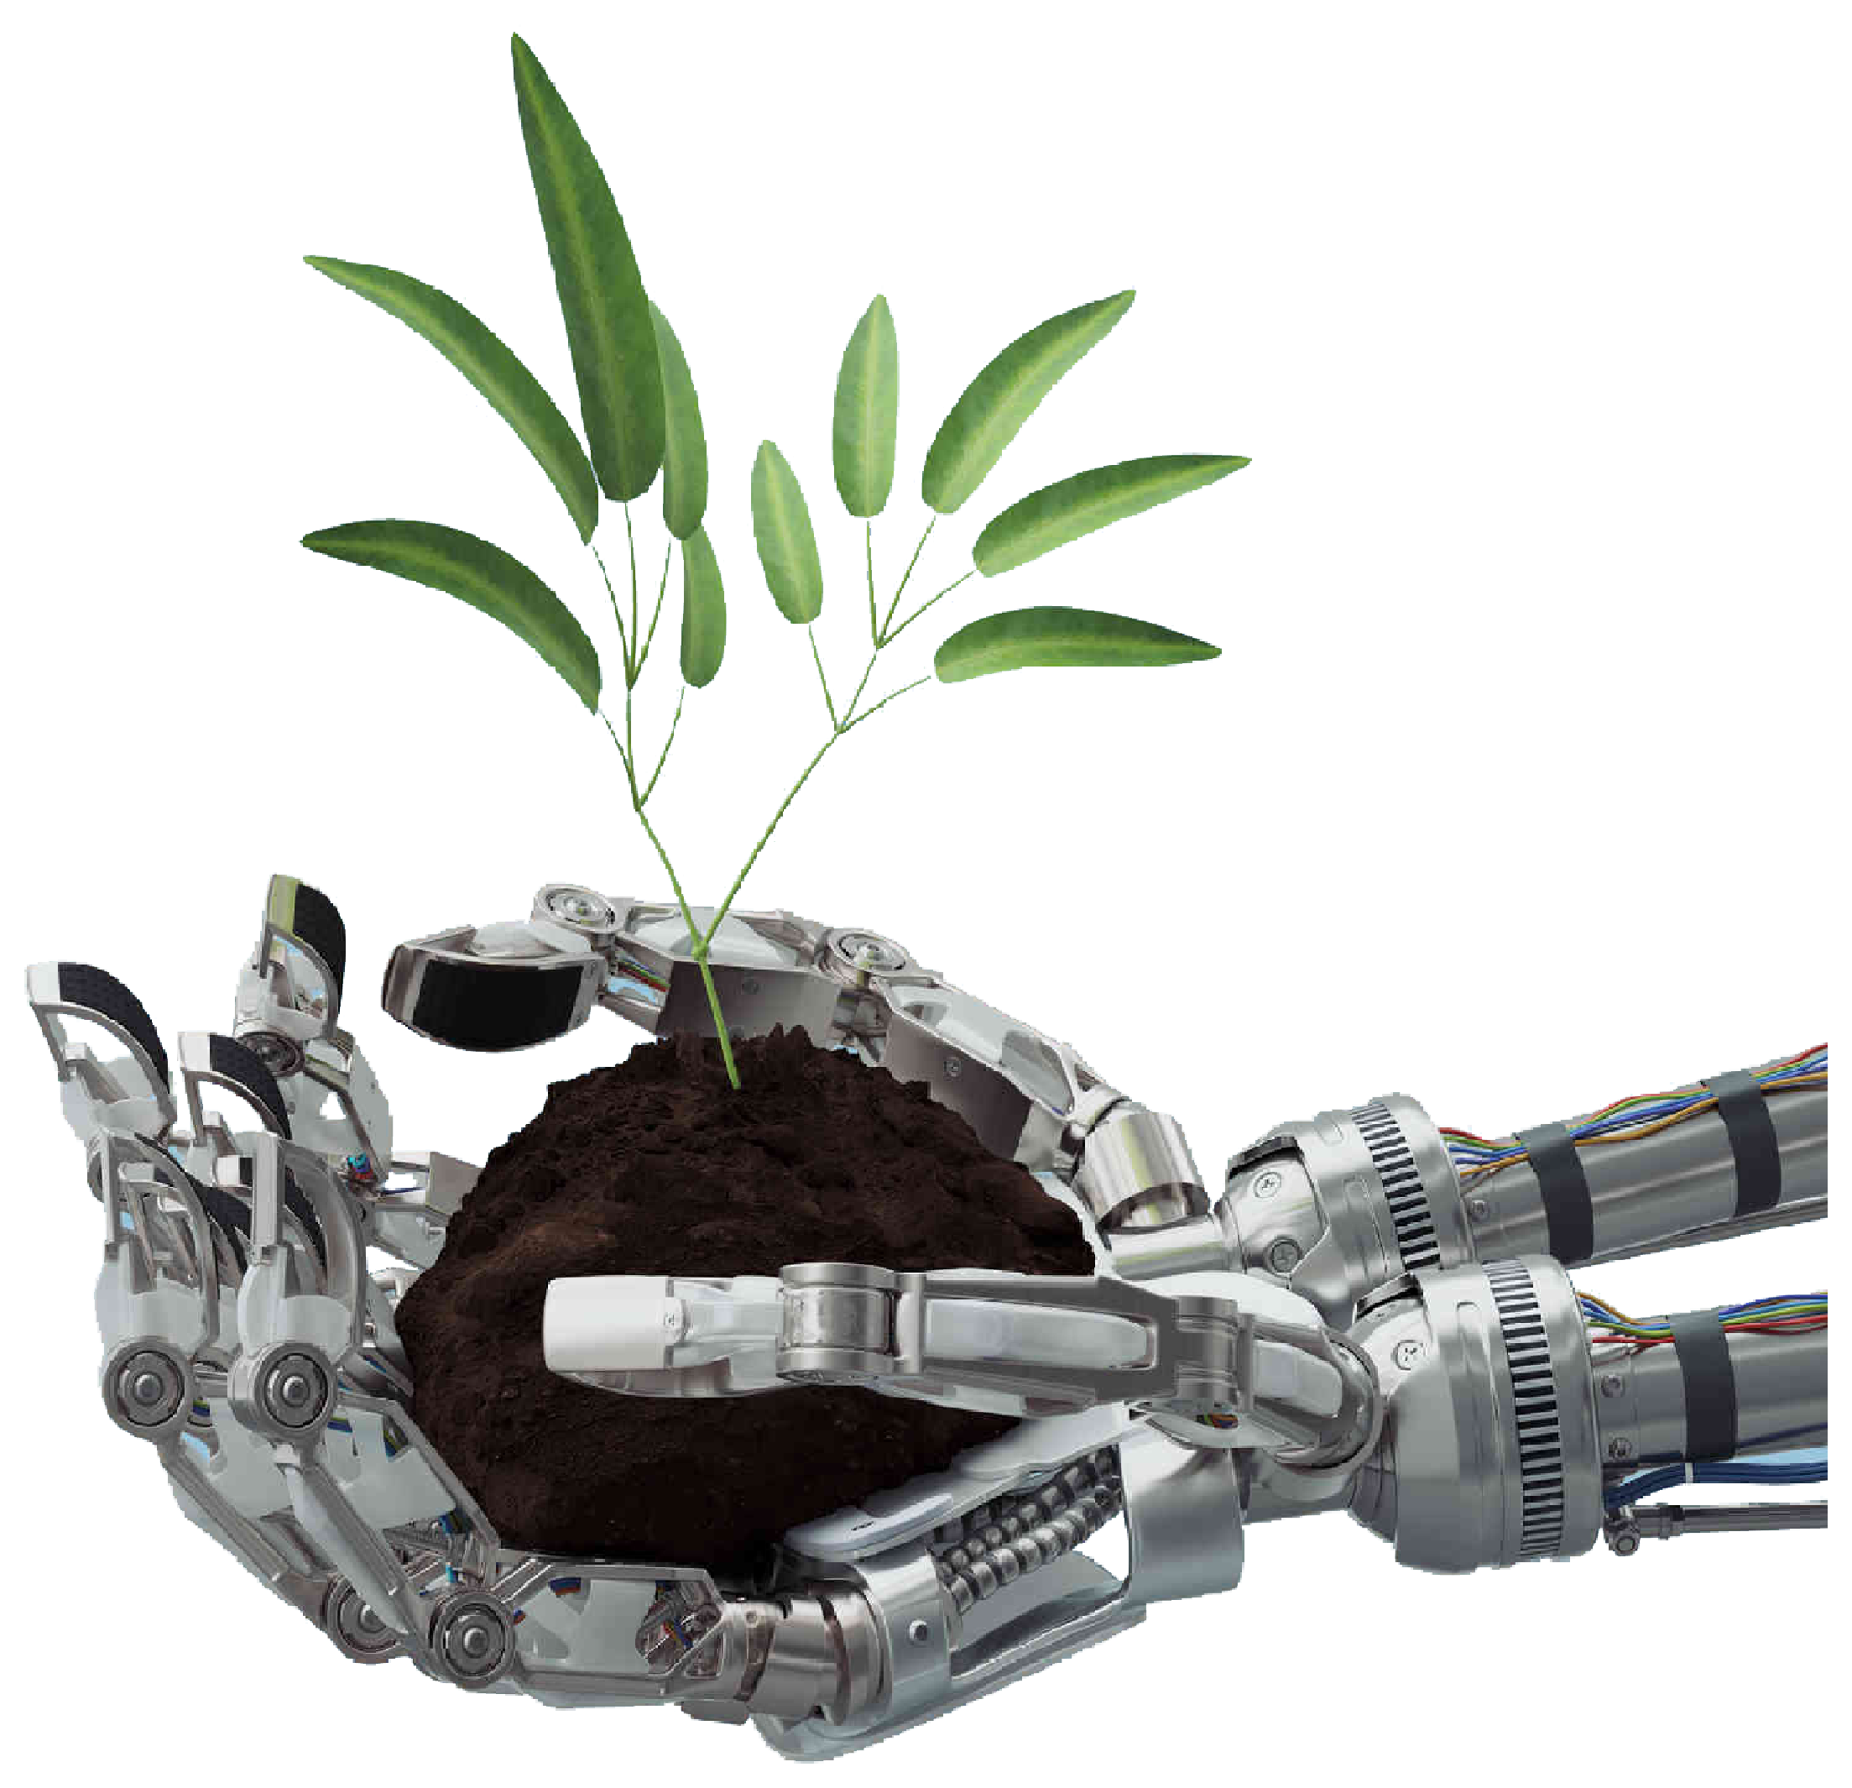
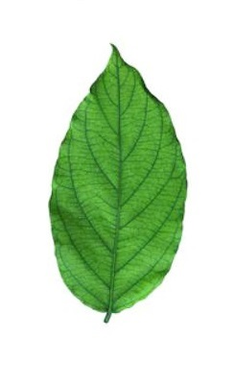
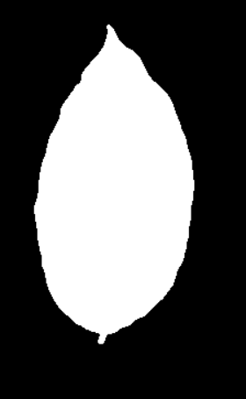
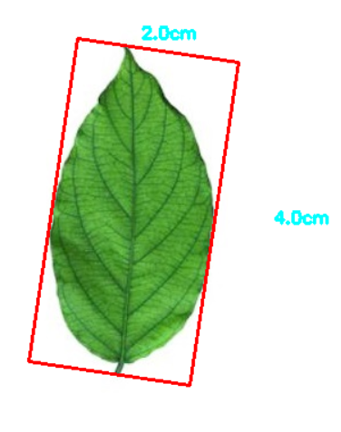
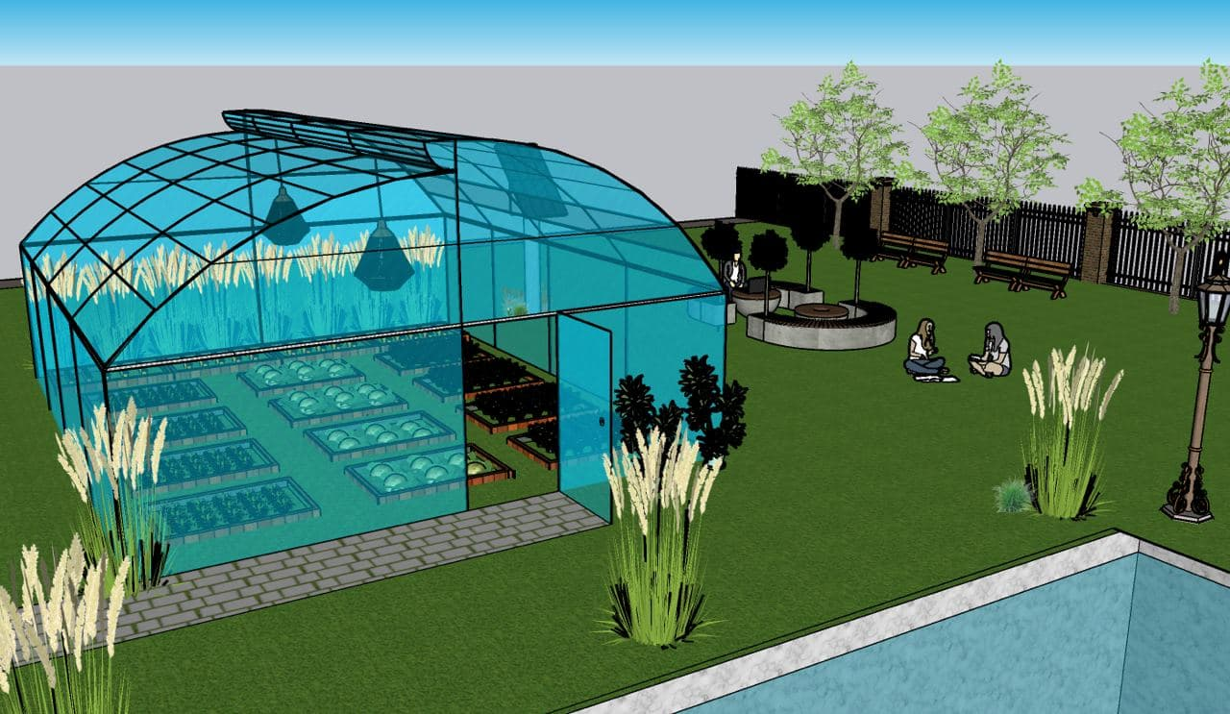
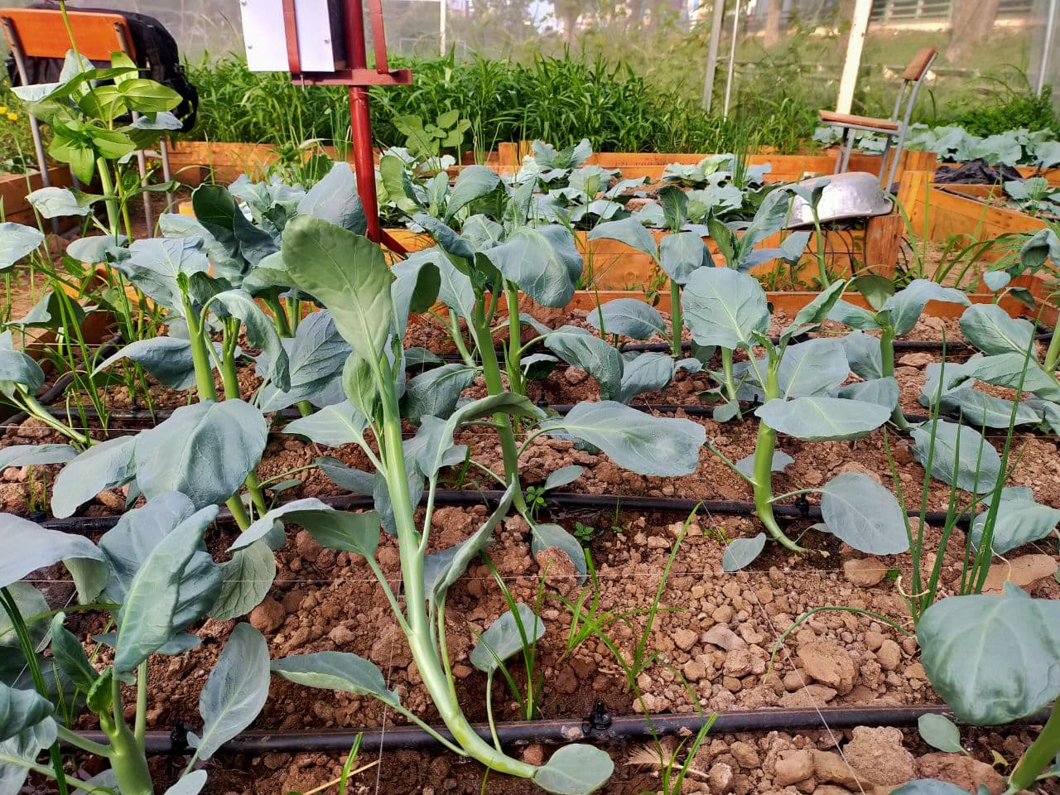
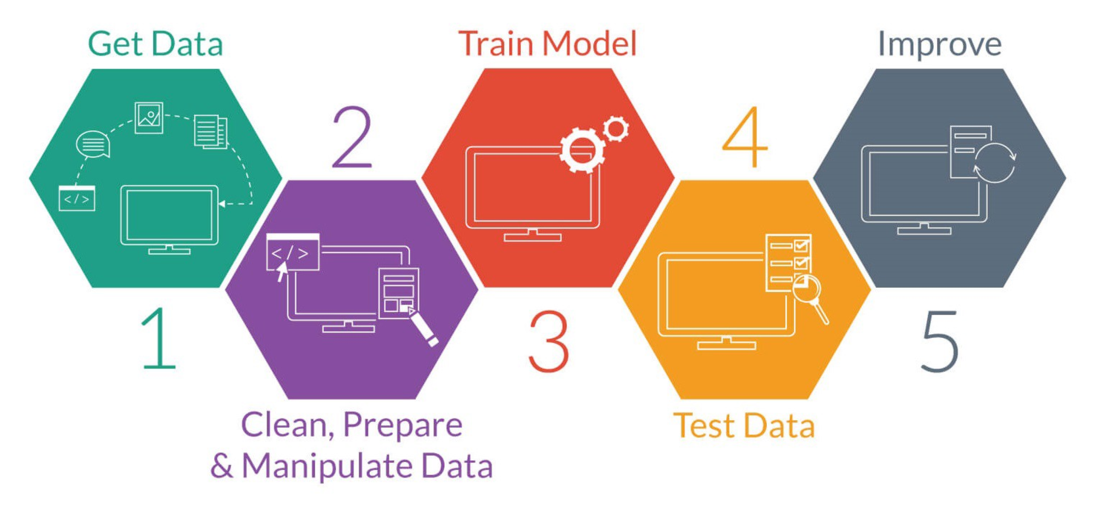
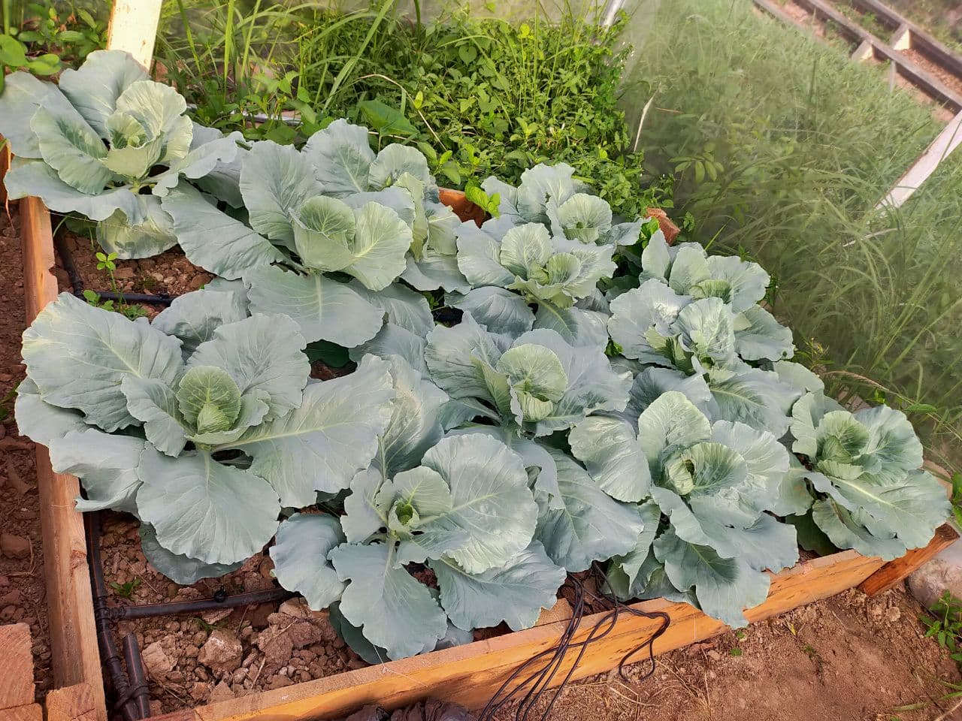
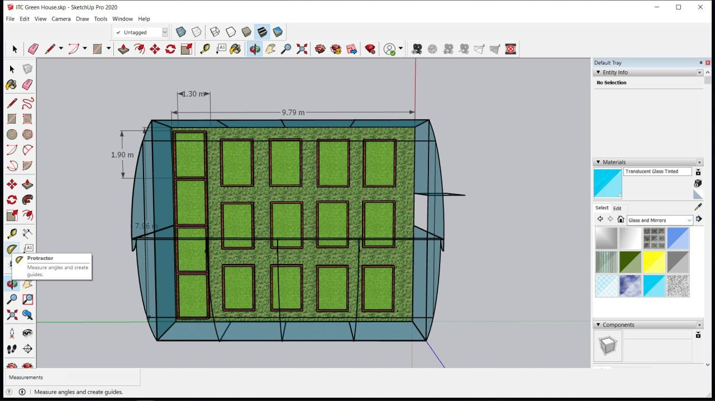
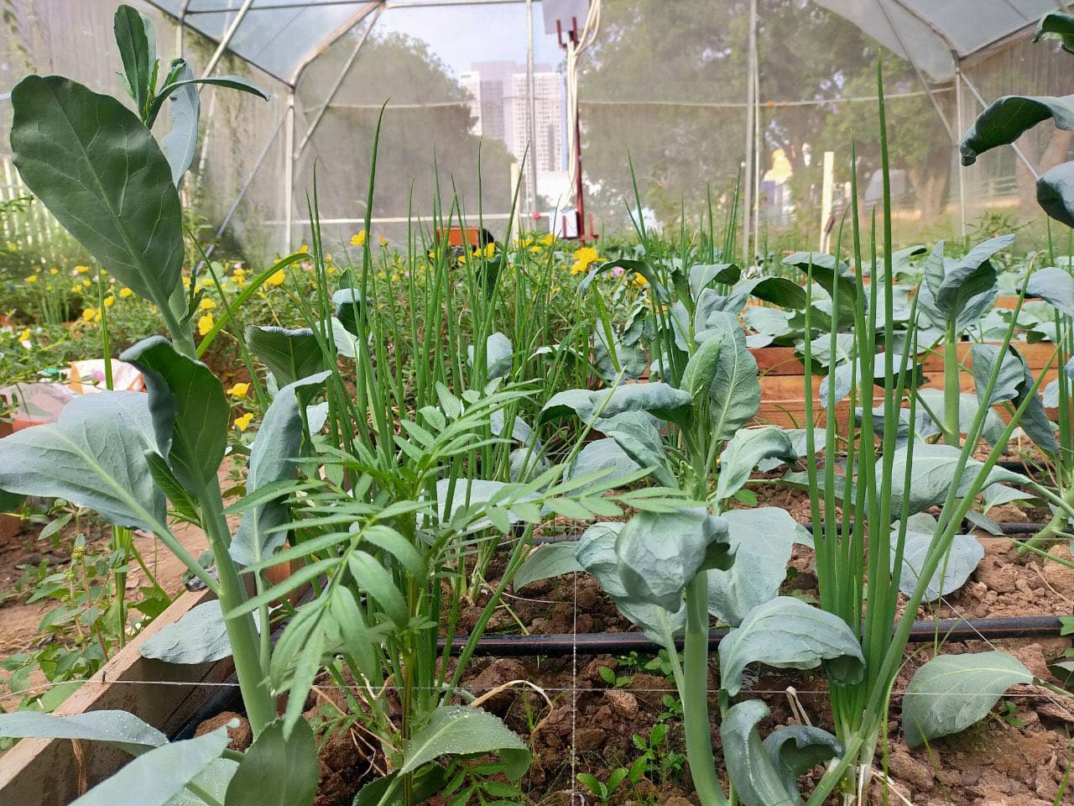
IOT PLATFORMS FOR SMART IRRIGATIONS
“AI FOR AGRICULTURE”
ADVISOR : HEL CHANTHAN
STUDENT : CHEK NITA
INTRODUCTION
PRE-
PROCESSING
Agriculture and farming is one of the oldest and most important professions in the world. Humanity has come a long way over the millennia in how we farm and frow crops with the introduction of various technologies and AI is one of the most modern application that has been used all around the world in this 4.1 industry technology region With AI and Agriculture we can build the most modern and convenience ways to apply and estimate data analytic for agriculture applications produce more product and farmers are able to control them.
With this technology we are going to built the systems where AI can predict the crops and plants on how its grow and it qualities ( height ,volume ,color..)
Before getting start in to Machine Learning ( AI ) , We need to pre-processing the image that we have been collected to make it convenience to filter our data and easier to store the them.
- Collect Data from Clouds, and all data are in photographs
- Clean and Prepare data and collect only study area
Use the filtration data and apply machine learning techniques to make an analysis
Train Data and Test Data
Make Prediction and improve the systems
d. Sample leaf
e. Leaf after filter
f. Detected size
leaf
DATA COLLECTION
RESULTS
SYSTEM
ARCHITECTURE
b. Smart Farm
By applying the AI into the agriculture applications we get :
- Convenience to control the data
- Emphasis on checking defective
crops and improving the potential for healthy crop production
- Have the potential to solve the challenges farmers face such as climate variation, an infestation of pests and weeds that reduces yields
The best part of implementing AI in agriculture that it won’t eliminate the jobs of human farmers rather it will improve their processes.
Plant (a)
We will use photo analysis to collect information from the actual plants and predict the yields of the crop and its production.
Plant (b)
a. System Architecture
Plant (c)
c. Smart Farm

